Slide 1
Schlumberger Excellence in Educational Development
Igniting passion for science and learning in youth and empowering them to use knowledge and technology creatively to meet the challenges of tomorrow.
August 2011
Notes:
© 2011 Schlumberger Excellence in Educational Development, Inc. All rights reserved. Permission is granted to make copies of this document for educational purposes only, provided that this copyright notice is reproduced in full. Contact SEED at SEED@slb.com for further information.

Slide 2
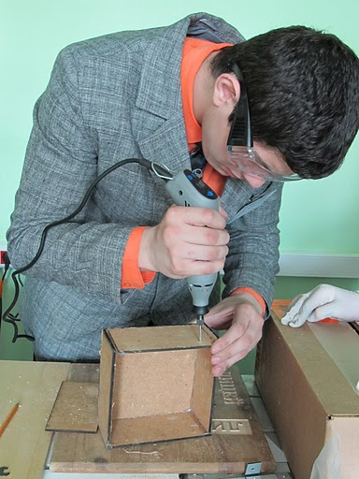
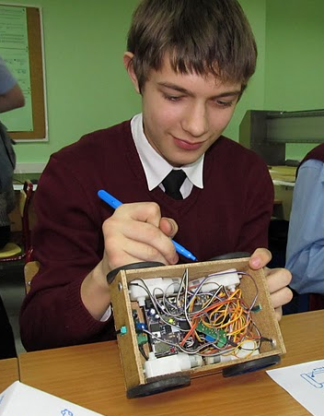
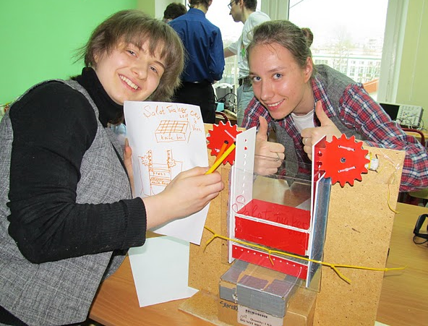
FabLab@School
Partnership between D. Euan Baird, SEED, Schlumberger, Stanford University, and MIT ‘s Center for Bits and Atoms .
Lyceum 1502 MPEI, a secondary school affiliated with the Moscow Power Energy Institute, is host to SEED’s first Fabrication Laboratory.
The FabLab@School is a small-scale workshop equipped
with advanced computer-controlled fabrication tools,
geared for the use of students and teachers in a high
school setting.
Students and teachers learn to use this equipment to build advanced science experiments, robots, machines, and other engineering projects.
Notes:
© 2011 Schlumberger Excellence in Educational Development, Inc. All rights reserved. Permission is granted to make copies of this document for educational purposes only, provided that this copyright notice is reproduced in full.

Slide 3
Schlumberger Excellence in Educational Development
For more information visit us at www.PLANETSEED.com
August 2011
Notes:
© 2011 Schlumberger Excellence in Educational Development, Inc. All rights reserved. Permission is granted to make copies of this document for educational purposes only, provided that this copyright notice is reproduced in full. Contact SEED at SEED@slb.com for further information.

